Slide 1

/Digital Forensics
DIGITAL-FORENSICS.HTML

Slide 2
/TABLE OF CONTENTS
/01
/INTRODUCTION
/02
/STEGANOGRAPHY
/03
/NETWORK FORENSICS
/04
/CONCLUSION & HANDS-ON
DIGITAL-FORENSICS.HTML

Slide 3

DISCLAIMER !!!
This workshop is intended for educational purposes only
NullSec will NOT be accountable if you use skills and knowledge shared to perform illegal or malicious attacks
DIGITAL-FORENSICS.HTML

Slide 4
/01
/INTRODUCTION TO FORENSICS
DIGITAL-FORENSICS.HTML

Slide 5
/FORENSICS
The process of collecting and analysing digital evidence. The goal is to preserve evidence in its most original form and perform a structured investigation on it.
What for?
Cybercrime investigations
Legal proceedings
Data recovery
More and more crimes involve digital devices, and these evidence must be handled properly.
DIGITAL-FORENSICS.HTML
Notes:
Digital forensics / forensics, is the process of collecting and analysing digital evidence. The first goal of it is to try to keep the evidence in its unaltered form, then performing a structure investigation in it.
This is because these days, there are more and more crimes that involve digital devices like your computers, and these evidence must be handled properly to ensure that all the evidence can be captured and analysed. These investigations can be done for cybercrime, legal proceedings, or even data recovery – like when your files are lost or corrupted.

Slide 6
/BRANCHES in Forensics
Multimedia Forensics AKA Steganography
Network Forensics
Computer Forensics
Mobile Forensics
And many more!
DIGITAL-FORENSICS.HTML
Notes:
Forensics can be a pretty broad field, having many branches like multimedia forensics, or steganography, network, computer, mobile forensics and many more. Today we'll be focusing on steganography and mobile forensics.

Slide 7
/02
/STEGANOGRAPHY
Image, videos, audio recordings, etc.
Used in hiding info / processing for analysis
DIGITAL-FORENSICS.HTML
Notes:
Steganography is essentially forensics of images, videos, audio recording and similar kinds of media. These media types are often used in hiding info, and we have to use steganography to process these for the analysis of them.

Slide 8
/MOST COMMON TYPES OF STEGANOGRAPHY
/IMAGE
/AUDIO
Hiding messages within image files
Making text hard to read
Embedding files within an image
Altering images’ metadata
Hiding messages within audio recordings
Morse Code
Altering Least Sig Bits
Altering frequencies
DIGITAL-FORENSICS.HTML
Notes:
Steganography can be broken down into two main types, which are image and audio steganography. Usually for images, includes hiding messages in images through methods like making the text very hard to read, embedding files within an image, and altering the image's metadata (which is basically data about the image, e.g. the location the image was taken at, or the camera model).
For audio steganography, it includes finding messages in audio recordings that can be hidden through various methods such as morse code, altering the bits of the audio file, or altering the frequency of the audio.
We will first go through image steganography methods.

Slide 9

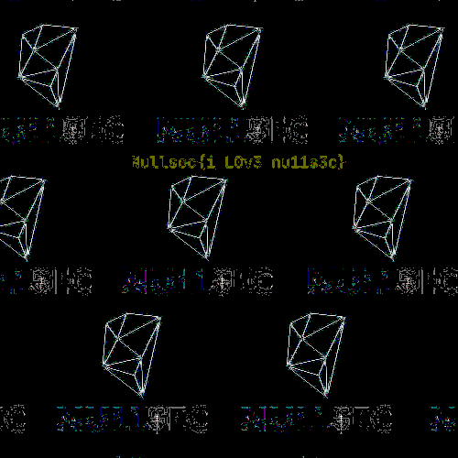

/IMAGE STEGANOGRAPHY METHODS 1. Magnify / Colour Alteration – Noise, Luminance, etc.
DIGITAL-FORENSICS.HTML

Slide 10
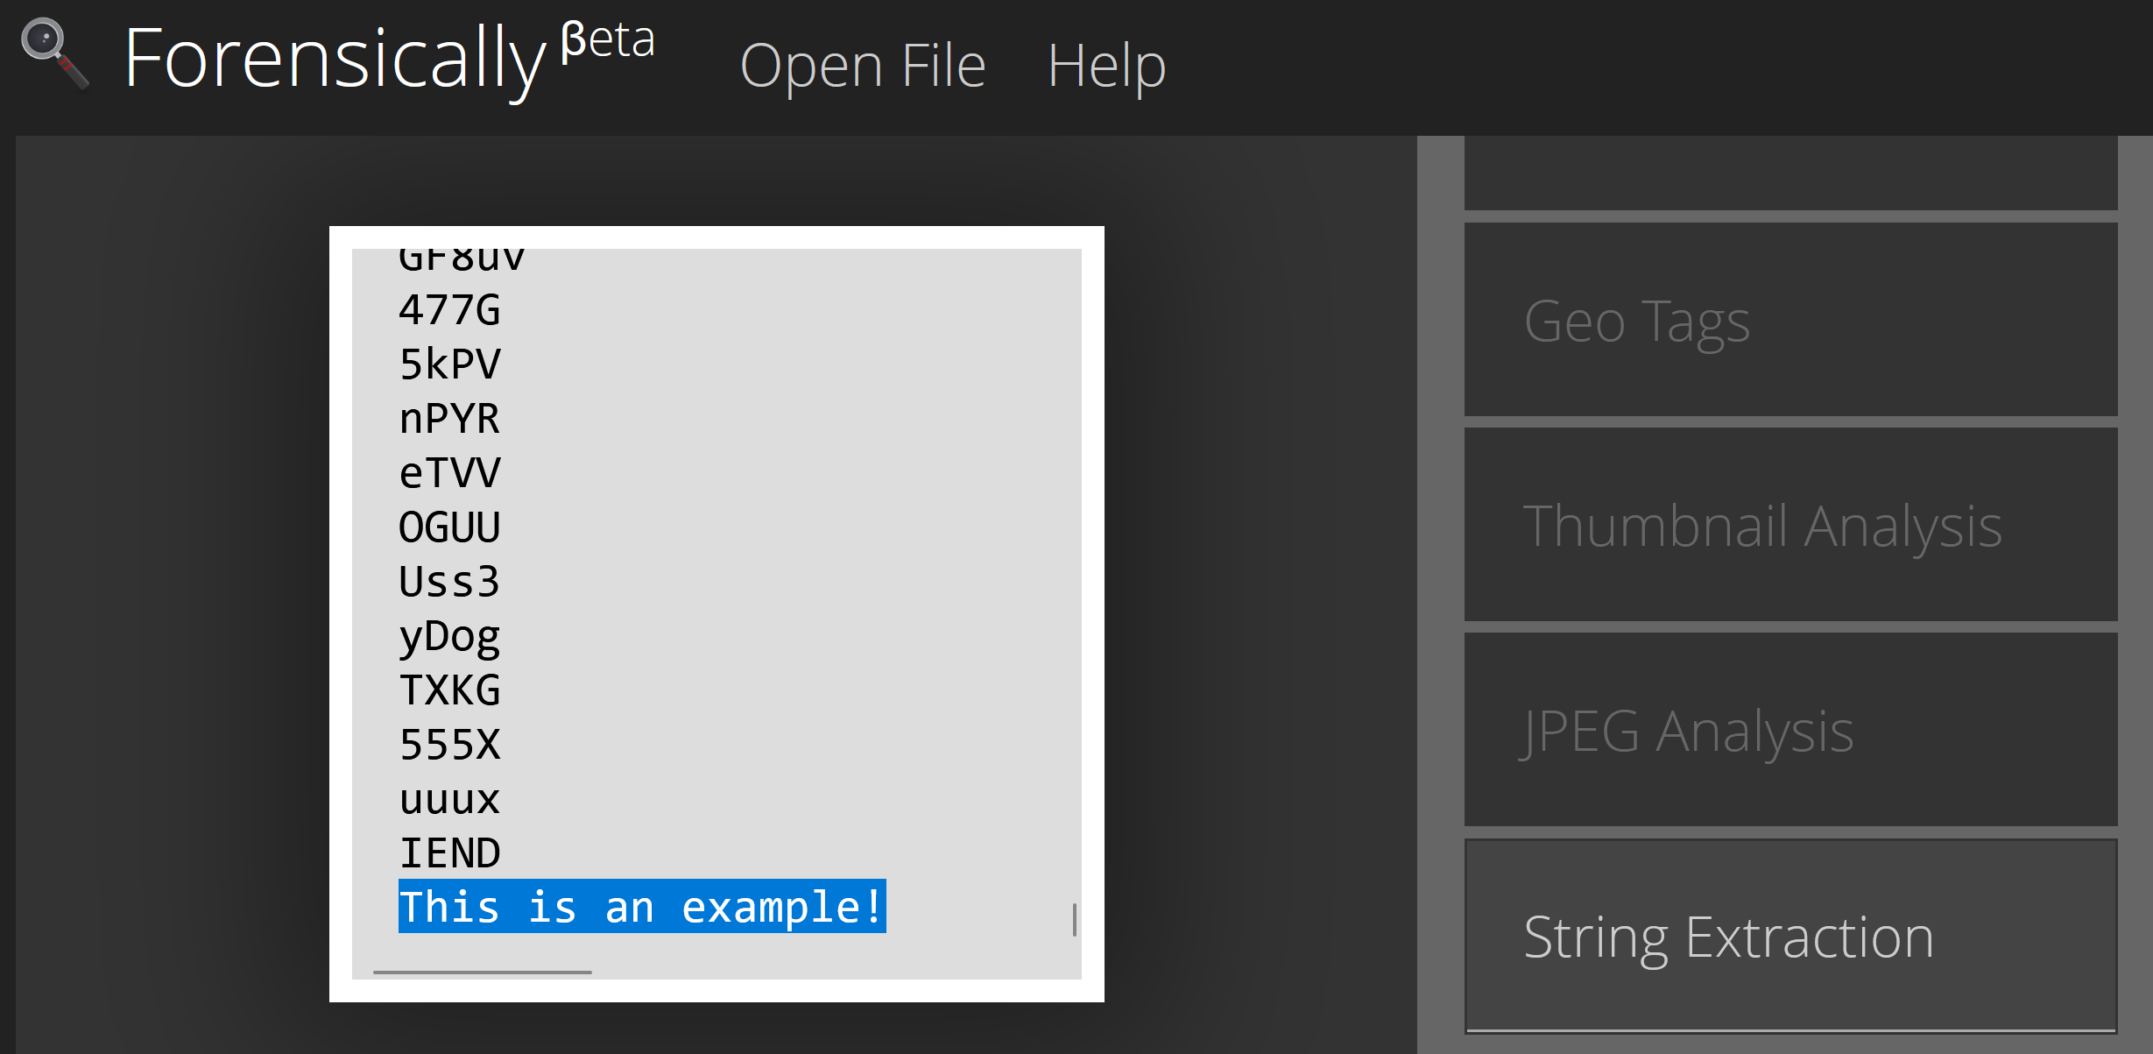
/IMAGE STEGANOGRAPHY METHODS 2. Strings
Pulls human-readable text from files
Image viewers ignore this
DIGITAL-FORENSICS.HTML
Notes:
IEND: Indicates the end of the image data.

Slide 11
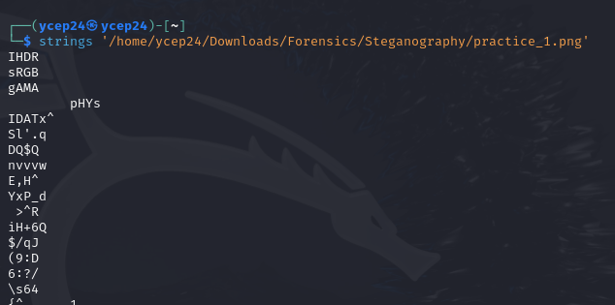

/IMAGE STEGANOGRAPHY METHODS 2. Strings – Using Terminal
DIGITAL-FORENSICS.HTML

Slide 12
/IMAGE STEGANOGRAPHY METHODS 3. Image Structure Alteration
1. PNG File Header (89 50 4E 47 0D 0A 1A 0A)
2. Chunks
2.1 Chunk Length
IHDR (Header)
Image dimensions, bit depth, etc.
PLTE (Palette)
List of colours in the image
IDAT (Data)
Actual image data
IEND (End)
Marks end of image data
2.2 Chunk Type – Identify chunk type
2.3 Chunk Data – Actual chunk’s data
2.4 CRC – Error detection value
DIGITAL-FORENSICS.HTML
Notes:
The next form of steganography is through methods of hiding messages by leveraging on the image structure. The way that image viewers know how to intepret an image, is through looking at the structure of the image and rendering it based on it. Lets look at an example of a PNG file structure.
Firstly, the PNG would have the PNG File Header, also known as the magic bytes. All PNG files have the same hex codes for the PNG file, which is these eight pairs of numbers/letters. The other parts of the PNG file is made out of chunks.
Each chunk carries information about it, such as the length of it, the type, the data, and an error detection value called the cyclic redundancy check or CRC.
There are many different types of chunks a PNG file can have, however there are four main compulsory chunks that a PNG must have, or it will not render properly. Firstly, it is the IHDR, or the header, which contains information about the image, like its dimensions, bit depth and more. There is also a palette, which is a list of colours to use to render the image. Then, there is the IDAT which contains the actual image data. Lastly, the IEND that we saw earlier, which marks the end of the image data.
Consists of chunks.
CRC = Cyclic Redundancy Check
Bit depth = No. of bits used to represent the colour of a single pixel
There are others, can refer to http://www.libpng.org/pub/png/spec/1.2/PNG-Chunks.html

Slide 13
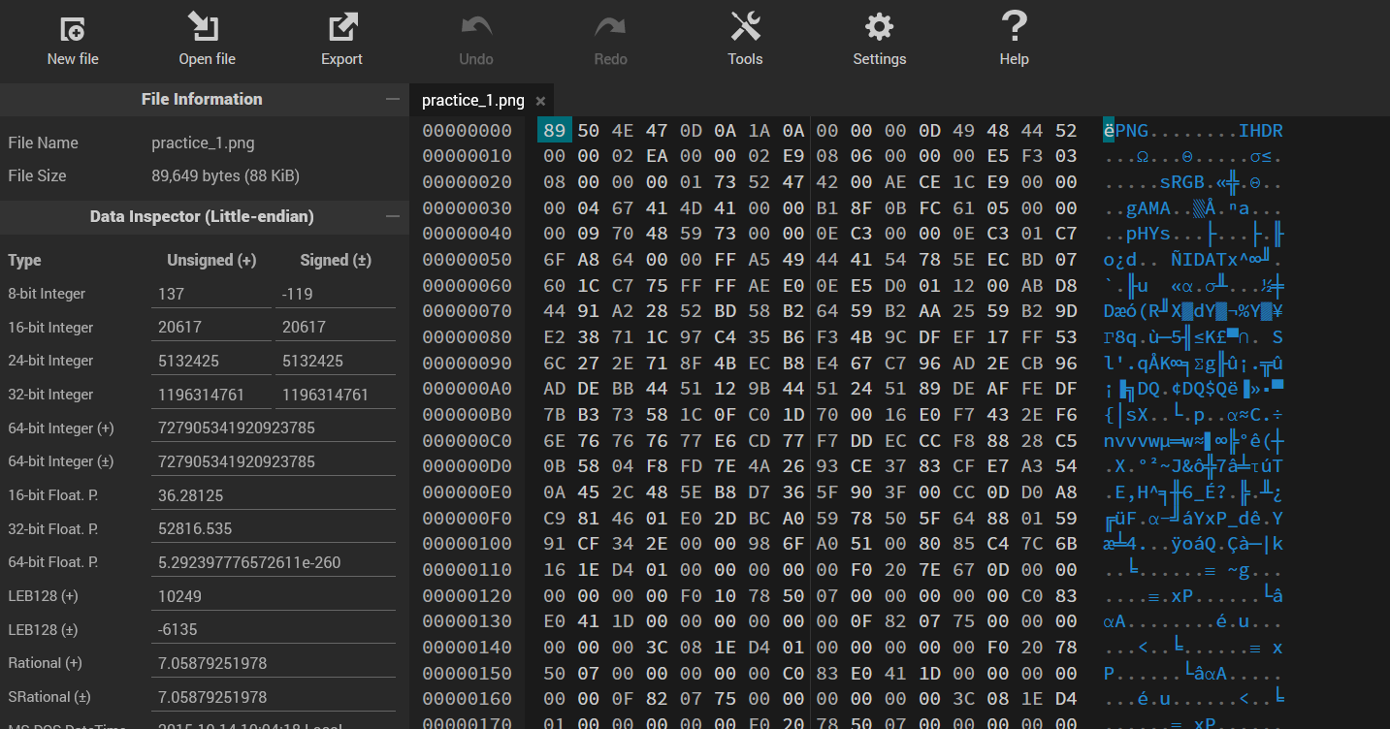
/IMAGE STEGANOGRAPHY METHODS 3. Image Structure Alteration
https://hexed.it/
DIGITAL-FORENSICS.HTML
Notes:
We can view the hex code of the images using a hexeditor tool. There can be online ones like hexed.it. For example, if we were to load in a file, we would be able to see all the various chunks and their names.

Slide 14
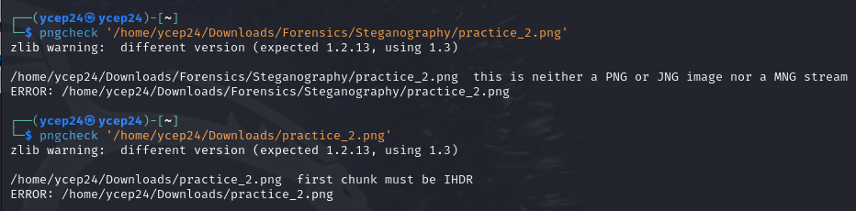
/IMAGE STEGANOGRAPHY METHODS 3. Image Structure Alteration – PNGcheck
DIGITAL-FORENSICS.HTML
Notes:
PNGcheck is a tool to verify the integrity of PNG files by checking the chunk information. Since it can be pretty tedious to manually check the PNG file for the corrupted chunks, PNGcheck can be used to detect where the corrupted chunks or errors are.

Slide 15
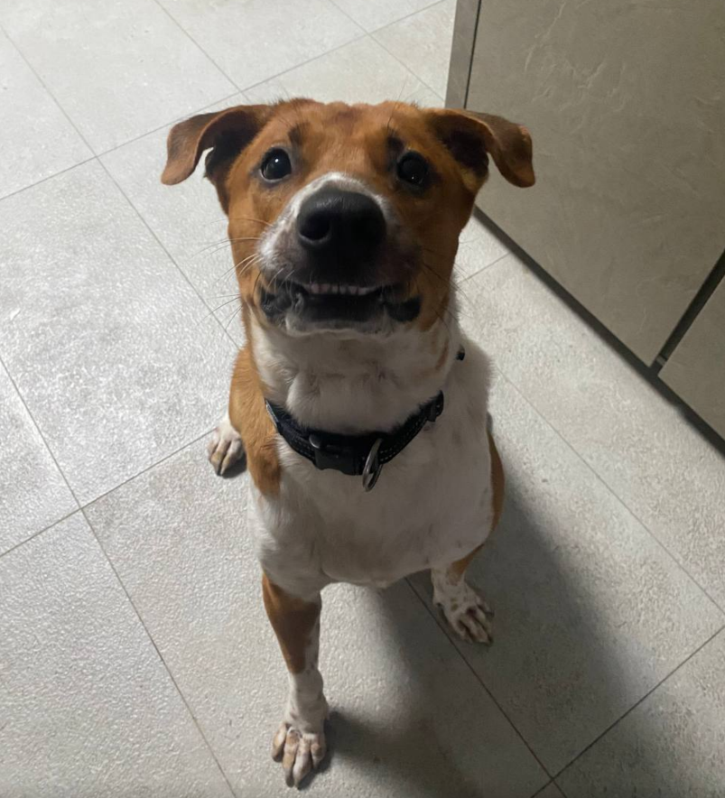
/IMAGE STEGANOGRAPHY METHODS 3. Image Structure Alteration – TRY IT YOURSELF!!!
DIGITAL-FORENSICS.HTML

Slide 16
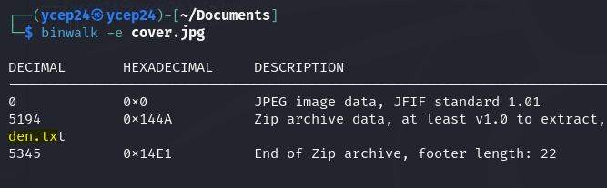
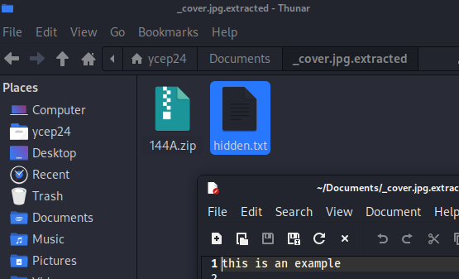
/IMAGE STEGANOGRAPHY METHODS 4. Binwalk
Extract embedded files from other files
DIGITAL-FORENSICS.HTML
Notes:
Binwalk is a tool to search a binary file for embedded files. It is similar to the strings method, which you find the text that is embedded at the end of the image.

Slide 17
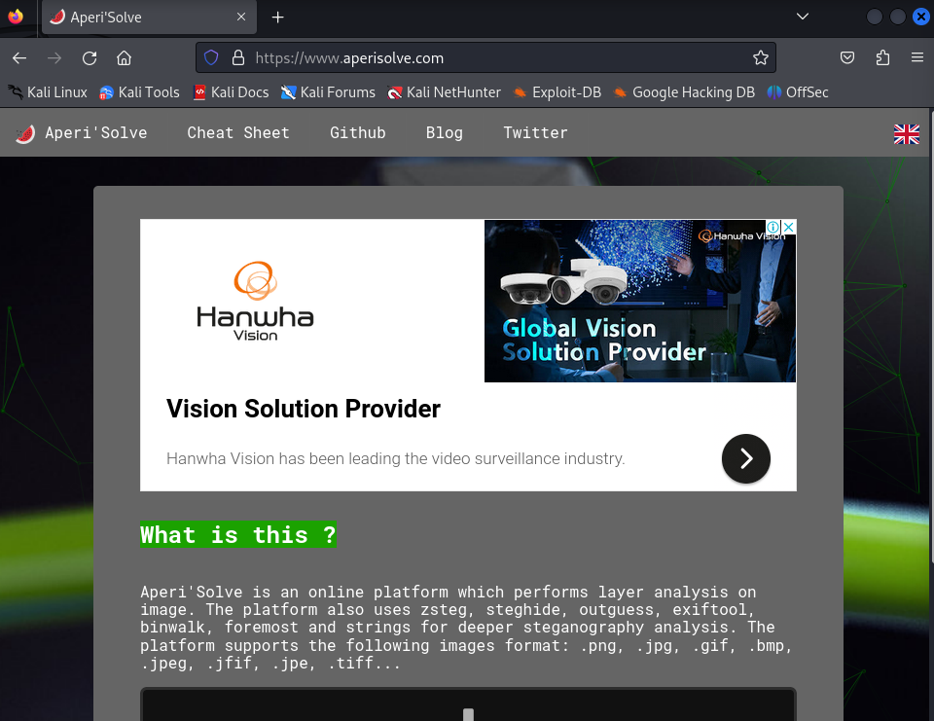
/IMAGE STEGANOGRAPHY TOOLS
DIGITAL-FORENSICS.HTML
Notes:
Runs a bunch of automatic tool on the image at once, which speeds up the process

Slide 18
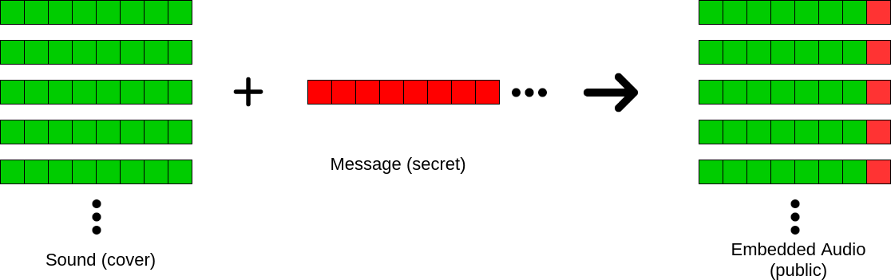
/AUDIO STEGANOGRAPHY METHODS 1. Alteration of Least Significant Bits (LSBs)
Our ears are insensitive to minor changes in audio signals :D
DIGITAL-FORENSICS.HTML
Notes:
Audio steganography is pretty similar to image steganography in a sense whereby you try to hide a message within the media form. One common method to hide a message is through altering the least significant bits. Binary files, like your audio files are stored in binary form, where there are groups of 8 blocks called bits. You can break up your message into bits, and replace the last bit of each group with the secret message.
So now, the hidden message is spreaded out into the groups of 8, like it’s the last bit of the group. This is possible because our human ears are really insensitive to small changes within audio files, and it would sound normal to us.
There are a lot of tools online available to extract the least significant bits, which you can easily google, so I won’t be going through this right now.

Slide 19
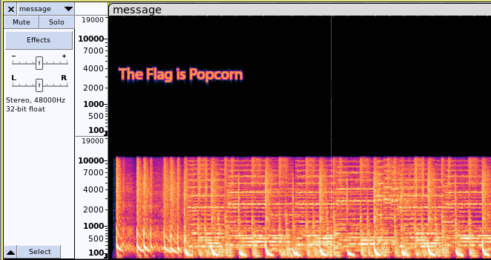
/AUDIO STEGANOGRAPHY METHODS 2. Alteration of Frequencies
Subtly changing the frequency of audio signals
DIGITAL-FORENSICS.HTML
Notes:
Another common way people would hide messages is through the alteration of frequencies, which include subtly changing the frequency of audio signals. This also leverages on how us humans are really insensitive to small changes in an audio file. This small changes have to be viewed using a spectrogram, which is how the frequencies within an audio file is mapped out into a graph.

Slide 20
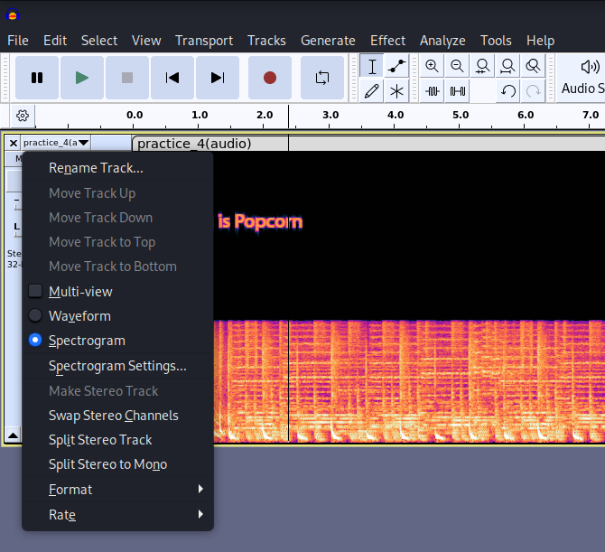
/AUDIO STEGANOGRAPHY METHODS 2. Alteration of Frequencies
Subtly changing the frequency of audio signals
DIGITAL-FORENSICS.HTML

Slide 21
/03
<NETWORK FORENSICS>
Analysing data from network devices like routers
DIGITAL-FORENSICS.HTML

Slide 22
/INTRODUCTION TO NETWORKING
Connecting multiple devices to allow them to communicate
These communications are governed by a set of rules called protocols. E.g. HTTP, FTP, and many others
Information transmitted over networks are divided into small chunks called packets
Protocol Info
Protocol Type
Source Addr
Source IP Addr
Source MAC Addr
Source Port No.
Dest. Addr
Dest. IP Addr
Dest. MAC Addr
Dest. Port No.
Data
Actual data!
Unique hardware address assigned to a device
Direct data to/from a specific service
DIGITAL-FORENSICS.HTML

Slide 23

/INTRODUCTION TO WIRESHARK
Packet analyser/capturing tool
Intercept data packets as they traverse a network
Monitors and analyses computer network traffic to gather information, legal evidence, etc.
DIGITAL-FORENSICS.HTML
Notes:
Capture packets
Find/Filter for HTTP traffic, read data
Export HTTP traffic

Slide 24
/04
/CTF Time!!!
DIGITAL-FORENSICS.HTML

Slide 25
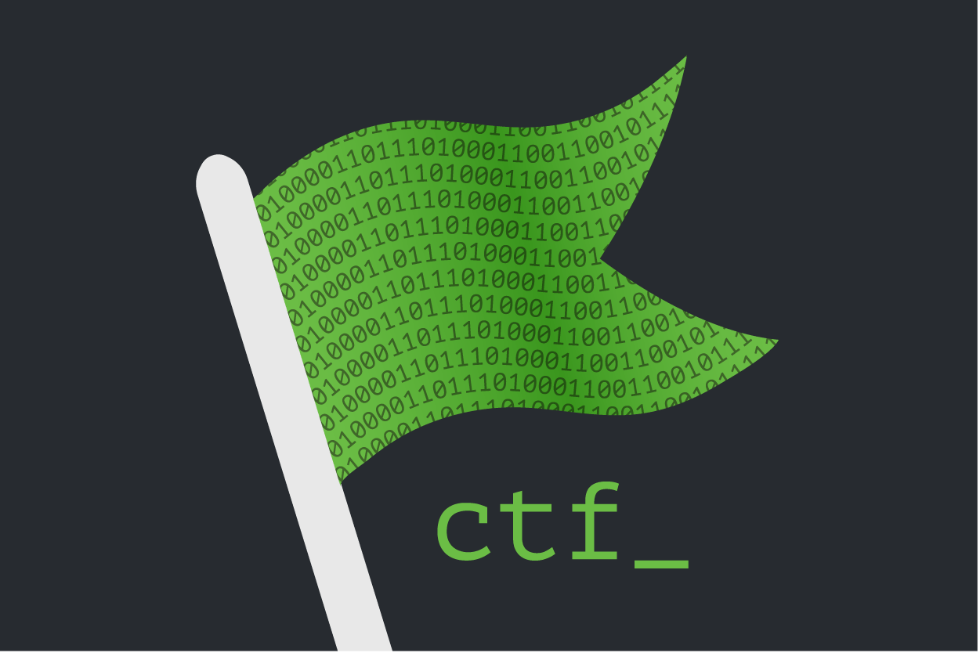
~$ man CTF
A competition that challenges YOUR ability to solve a variety of tasks hidden in vulnerable programs, websites, etc.
You will receive a text string (AKA a flag) when you successfully exploit the challenge.
NULL{7h1s_i5_4n_3x4mp13}
CTF will be live on ctf.nullsec.com at 7.50pm sharp!
WORKSHOP.HTML

Slide 26
ATTENDANCE!!

Slide 27
/THANKS!
/DO YOU HAVE ANY QUESTIONS?
nullsec.sig@gmail.com
https://nullsecsig.com/#/
Please keep this slide for attribution
DIGITAL-FORENSICS.HTML

